Slide 1


M.Sc. Computer Science, School of technology,
DOON UNIVERSITY
Dehradun, Uttarakhand
Smart Resume Analyzer
Name: ANUBHAV SINGH
Roll No.: 21CS-05

Slide 2

Introduction:
Modifying Resume
Value
In today's competitive job market, an effective resume is most important. This presentation introduces the Smart Resume Analyzer, a cutting-edge tool designed to automate and enhance the resume evaluation process. It provides an essential overview of its functionalities and highlights the critical importance of automated tools in modern hiring.

Slide 3




Literature Review: Evolving Resume Analysis
Previous research into Applicant Tracking Systems (ATS) mainly focused on keyword scanning, section detection, and Natural Language Processing (NLP) for basic resume screening. Our innovative system refines this approach by combining robust PDF parsing with an advanced rule-based NLP engine.
Keyword Scanning
Section Detection
Traditional ATS relies heavily on matching keywords.
Identifying standard resume sections.
Basic NLP
PDF Parsing + Rule-Based NLP
Fundamental linguistic analysis of text.
Our simplified yet powerful approach.

Slide 4

Motivation: Bridging the Resume Feedback Gap
Student Self-Evaluation Challenges
Time-Consuming Manual Review
Students often lack the expertise to objectively evaluate their own resumes, leading to missed opportunities.
Manual resume checks are inefficient and impractical for large volumes of applications, delaying critical feedback.
Demand for Instant, Actionable Feedback
There's a significant need for tools that provide quick, constructive, and meaningful feedback to job seekers.

Slide 5
Objectives: Our Analytical Goals
Our primary objective is to develop a user-friendly, NLP-based web application designed to allow fresh graduates by
offering sharp resume analysis. This application will:
Extract Resume Text
Identify Main Sections
Match Keywords to Job Role
Accurately parse and extract all textual content from various resume formats.
Automatically detect and categorize key resume sections such as experience, education, and skills.
Analyze resume content against relevant keywords for specific job roles to assess suitability.
Generate Score & Suggestions
Provide Downloadable Report
Provide a comprehensive score and actionable suggestions for improvement.
Offer a detailed, user-friendly report for offline review and application.

Slide 6






Methodology: Our Step-by-Step Approach
Our Smart Resume Analyzer follows a streamlined process to deliver accurate and insightful evaluations.
Upload PDF
Users securely upload their resume in PDF format.
Extract Text (pdfplumber)
Utilize pdfplumber for accurate text extraction from the uploaded PDF.
Section Detection
Key sections are identified using advanced parsing techniques.
Keyword Analysis
Content is analyzed for keywords relevant to target job roles.
Score Calculation
An overall resume score is computed based on various criteria.
Suggestions Generation
Personalized recommendations for improvement are provided.

Slide 7

Technology Stack: Powering the Analyzer
Python: The core programming language for backend logic and NLP.
Regex (Regular Expressions): Utilized for sophisticated keyword and pattern detection within the resume text.
Streamlit: For developing the interactive and user-friendly web application interface.
Basic NLP (String Matching): Implementing fundamental Natural Language Processing techniques for effective content analysis.
pdfplumber: A robust library for efficient and precise PDF document parsing and text extraction.

Slide 8
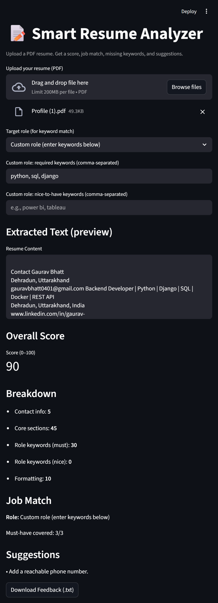
Results: A Snapshot of Success
The Smart Resume Analyzer provides clear, actionable feedback, helping users quickly understand their resume's strengths and areas for improvement.
Example Score: 90/100
Suggestions:
This score reflects a strong resume, but with room for optimization to achieve a perfect match for target roles.
Add a reachable phone number.

Slide 9




Key Advantages: Why Our Solution Stands Out
Fast & Easy to Use
No Complex Infrastructure
Provides instant feedback, saving valuable time for job seekers.
Operates without external databases or complex ML models, ensuring simplicity.
Immediate, Explainable Feedback
Adaptable to Any Role
Offers clear and understandable suggestions for improvement, supporting user learning.
Easily configurable with new keyword sets for diverse job roles.

Slide 10


Challenges: Navigating Complexities
1
2
Variations in PDF Structure
Scanned/Unreadable Resumes
Resumes come in countless layouts, making consistent data extraction a significant hurdle.
Dealing with image-based or poorly scanned PDFs that lack readable text creates a challenge for text extraction.
3
Semantic Meaning of Keywords
A simple keyword search can often miss the refined meaning and context, leading to inaccurate evaluations.

Slide 11




Future Work: Expanding Capabilities
Integrate Machine Learning
Leverage ML algorithms for predictive analytics and more accurate resume scoring.
Semantic Keyword Detection
Implement advanced NLP for understanding context and synonyms, moving beyond exact keyword matches.
DOCX File Support
Expand compatibility to include .docx files, serving to a wider user base.
Job Description Matching
Develop functionality to directly match resume content against specific job descriptions for custom feedback.

Slide 12

Conclusion: Empowering Resume Perfection
The Smart Resume Analyzer represents a significant leap forward in resume evaluation, offering rapid, clear, and constructive feedback.
By integrating advanced NLP and rule-based systems, it effectively helps students and job seekers refine their resumes, ensuring they stand out in a competitive landscape.
Our system supports individuals to enhance their professional presentation and pursue their career ambition with greater confidence.

Slide 13

Thank You
We appreciate your time and attention today. The Smart Resume Analyzer is poised to transform how job seekers approach their career journey.

